Slide 1
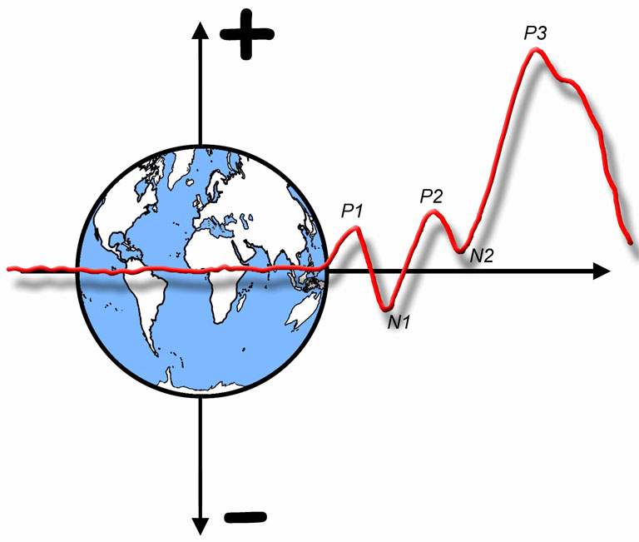

The ERP Boot Camp
Examples of Experimental Design

Slide 2
Sustained Visual-Spatial Attention
Stimuli
Left standards (p = .4)
Left deviants (p = .1)
Right standards (p = .4)
Right deviants (p = .1)
Duration = 100 ms; SOA = 300-500 ms
Conditions
Attend left (press for left deviants)
Attend right (press for right deviants)
Also…
Maintain fixation (verify with EOG)
Notes:
© S. J. Luck. All Rights Reserved. May be used for nonprofit educational purposes if this copyright notice is included. Permission must be obtained from the copyright holder(s) for any other use.

Slide 3
Sustained Visual-Spatial Attention
Comparison of Attended and Ignored Standards
O1/O2
Things to notice:
Same stimuli; different psychological conditions
Time 0 is stimulus onset
Assumption: Early in time means early in information processing sequence
Conclusion: Attention influences sensory processing
“Upper bound” on onset time
Hard to test this with behavioral experiments
Time relative to stimulus onset
Does the conclusion depend on whether it is the P1 wave per se that is influenced by attention?
Notes:
© S. J. Luck. All Rights Reserved. May be used for nonprofit educational purposes if this copyright notice is included. Permission must be obtained from the copyright holder(s) for any other use.

Slide 4
Sustained Visual-Spatial Attention
Things to notice:
Standard/Deviant comparison not perfectly controlled
Nonspatial selection operates later than spatial selection
Almost any effect can be called an “attention effect” – effects before 100 ms occur only as a result of shifts of spatial attention prior to stimulus onset(with a few rare exceptions)
Notes:
© S. J. Luck. All Rights Reserved. May be used for nonprofit educational purposes if this copyright notice is included. Permission must be obtained from the copyright holder(s) for any other use.

Slide 5
Sustained Auditory Attention
Stimuli
Left standards (p = .4)
Left deviants (p = .1)
Right standards (p = .4)
Right deviants (p = .1)
SOA = 120-320 ms
Conditions
Attend left (press for left deviants)
Attend right (press for right deviants)
Notes:
© S. J. Luck. All Rights Reserved. May be used for nonprofit educational purposes if this copyright notice is included. Permission must be obtained from the copyright holder(s) for any other use.

Slide 6
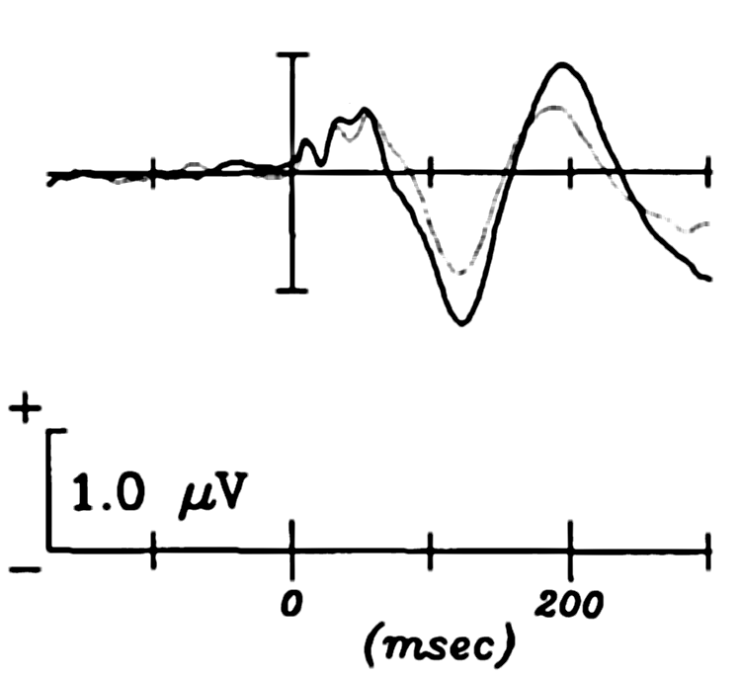
Sustained Auditory Attention
ERP to Left Standards
MLRs
P2
Assumption: Early in time means early in information processing sequence
Conclusion: Attention influences sensory processing
C3
N1
Attend Left
Attend Right
Woldorff & Hillyard (1991)
Notes:
© S. J. Luck. All Rights Reserved. May be used for nonprofit educational purposes if this copyright notice is included. Permission must be obtained from the copyright holder(s) for any other use.

Slide 7
The Attentional Blink
T2-Only Condition (Report only T2 at end of trial)
T2 Detection Accuracy
Dual-Task Condition (Report T1 and T2 at end of trial)
Notes:
© S. J. Luck. All Rights Reserved. May be used for nonprofit educational purposes if this copyright notice is included. Permission must be obtained from the copyright holder(s) for any other use.

Slide 8
What Causes the Blink?
Are subjects unable to identify T2 during the AB?
Or do they see it and fail to store it in working memory?
Previous research shows that we can perceive even complex pictures at 8/sec
We ought to be able to perceive letters at 10/sec
Logic of study
Early sensory suppression during AB (P1 & N1)?
Late perceptual suppression during AB (N400)?
Postperceptual working memory suppression (P3)?
Notes:
© S. J. Luck. All Rights Reserved. May be used for nonprofit educational purposes if this copyright notice is included. Permission must be obtained from the copyright holder(s) for any other use.

Slide 9
Experiment 1: P1 and N1
T1 Task: Digit Odd or Even?
T2 Task: Red item Vowel or Consonant?
Prediction: No P1/N1 suppression during AB
Notes:
© S. J. Luck. All Rights Reserved. May be used for nonprofit educational purposes if this copyright notice is included. Permission must be obtained from the copyright holder(s) for any other use.

Slide 10
Overlap Problem
Notes:
© S. J. Luck. All Rights Reserved. May be used for nonprofit educational purposes if this copyright notice is included. Permission must be obtained from the copyright holder(s) for any other use.

Slide 11
Experiment 1 Results
Notes:
© S. J. Luck. All Rights Reserved. May be used for nonprofit educational purposes if this copyright notice is included. Permission must be obtained from the copyright holder(s) for any other use.

Slide 12
Experiment 1 Results
Difficult to draw strong conclusions from the lack of an ERP effect
Notes:
© S. J. Luck. All Rights Reserved. May be used for nonprofit educational purposes if this copyright notice is included. Permission must be obtained from the copyright holder(s) for any other use.

Slide 13
Experiment 2: N400
How to demonstrate that T2 was fully identified?
Show that it can elicit an N400
Sweet …. Sugar
Hot …. Sugar
If a semantic mismatch is detected when T2 is a word, then T2 must have been fully identified
Notes:
© S. J. Luck. All Rights Reserved. May be used for nonprofit educational purposes if this copyright notice is included. Permission must be obtained from the copyright holder(s) for any other use.

Slide 14
Experiment 2: N400
Notes:
© S. J. Luck. All Rights Reserved. May be used for nonprofit educational purposes if this copyright notice is included. Permission must be obtained from the copyright holder(s) for any other use.

Slide 15
The Overlap Problem
Notes:
© S. J. Luck. All Rights Reserved. May be used for nonprofit educational purposes if this copyright notice is included. Permission must be obtained from the copyright holder(s) for any other use.

Slide 16
Experiment 2 Results
Notes:
© S. J. Luck. All Rights Reserved. May be used for nonprofit educational purposes if this copyright notice is included. Permission must be obtained from the copyright holder(s) for any other use.

Slide 17
Experiment 2 Results
Does it matter whether this is really an N400?
Notes:
© S. J. Luck. All Rights Reserved. May be used for nonprofit educational purposes if this copyright notice is included. Permission must be obtained from the copyright holder(s) for any other use.

Slide 18
Experiment 3: Control
Is N400 sensitive to modest changes in perceptibility?
Does even a slight perceived mismatch cause a large N400?
Notes:
© S. J. Luck. All Rights Reserved. May be used for nonprofit educational purposes if this copyright notice is included. Permission must be obtained from the copyright holder(s) for any other use.

Slide 19
Experiment 4: P3
Isolate P3 by subtracting frequent T2 from rare T2
Notes:
© S. J. Luck. All Rights Reserved. May be used for nonprofit educational purposes if this copyright notice is included. Permission must be obtained from the copyright holder(s) for any other use.

Slide 20
Experiment 4 Results
Notes:
© S. J. Luck. All Rights Reserved. May be used for nonprofit educational purposes if this copyright notice is included. Permission must be obtained from the copyright holder(s) for any other use.

Slide 21
Experiment 4 Results
Does it matter whether this is really a P3?
Notes:
© S. J. Luck. All Rights Reserved. May be used for nonprofit educational purposes if this copyright notice is included. Permission must be obtained from the copyright holder(s) for any other use.

